Slide 1

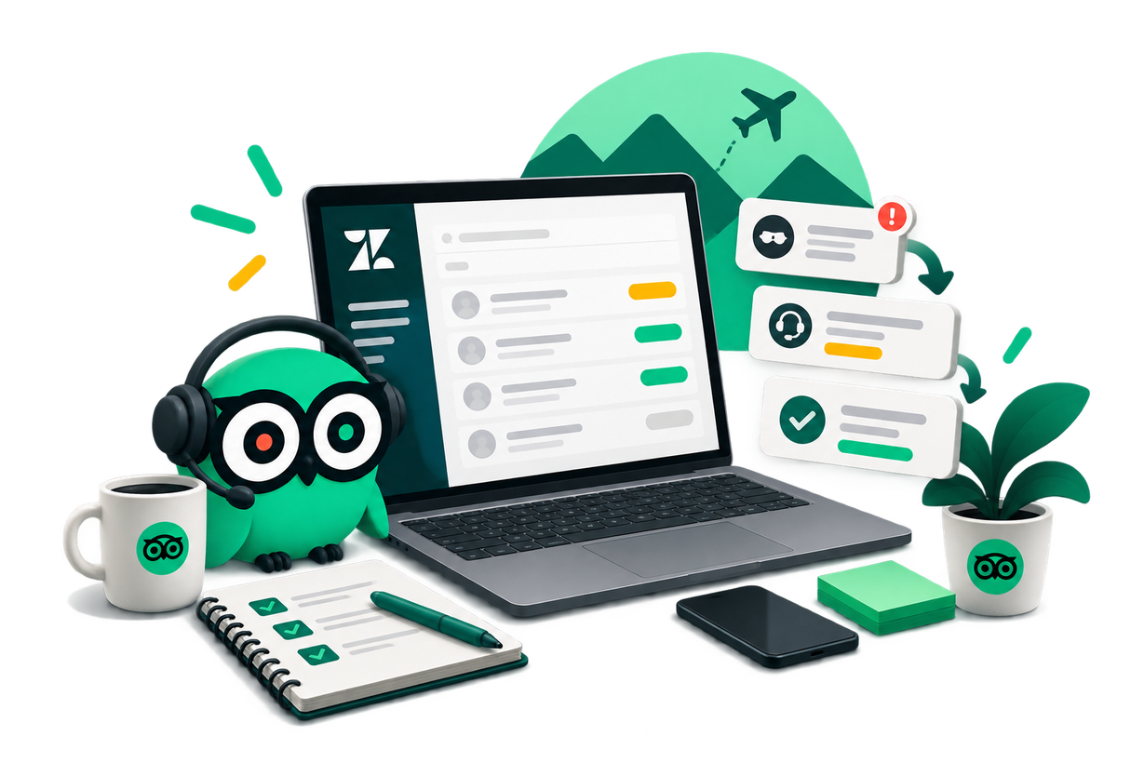
“Zendesk Introduction”
Your everyday tool for managing fraud support tickets — from navigation to resolution.
Notes:
1

Slide 2
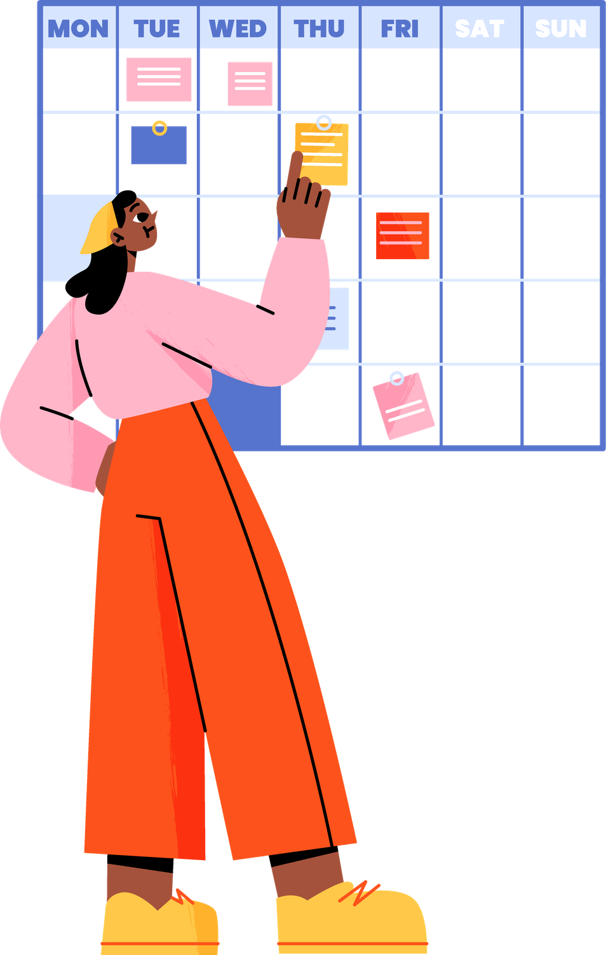

Agenda
Zendesk Overview
Let’s explore our everyday tool!
Interface & Navigation
Let’s take a short trip into the tool!
Communication Notes
Learn the importance of note types
How to work on a ticket
Understand how to process duplicate tickets
Tripadvisor / Fraud support / Agenda

Slide 3
Zendesk Overview
What is it?
Primary CRM and ticketing platform for Fraud Support
What does it do?
Tracks, manages, and resolves incoming support requests
How does it function?
Connects agents directly with owners, users, and reviewers
How are tickets managed?
Directs tickets automatically by language, priority, and agent skill set
Tripadvisor / Fraud support / Zendesk overview

Slide 4
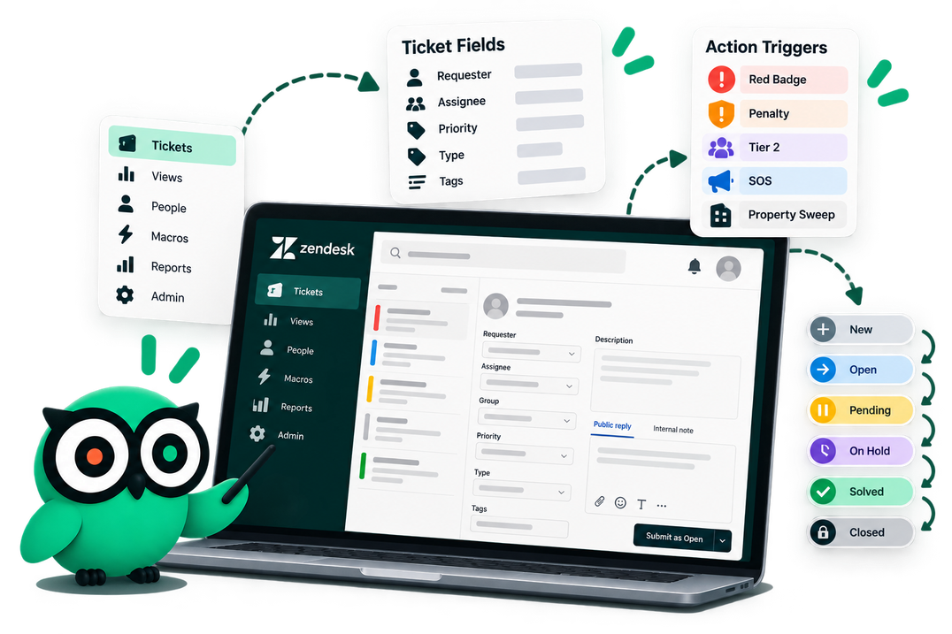
01. Interface & Navigation
A quick trip into the tool — learn where everything lives and what the key fields mean.

Slide 5


Left-Side Panel – Ticket Fields
Essential Case Data Entry
Filling out the fields in the left section will populate the following with links to open the ticket in the respective tools (URD and LC):
Review ID
Location ID
Purpose
Mandatory Entry
Location ID
Review ID
Ticket Reason
Sample image
Sample image
Tripadvisor / Fraud support / Interface & navigation

Slide 6
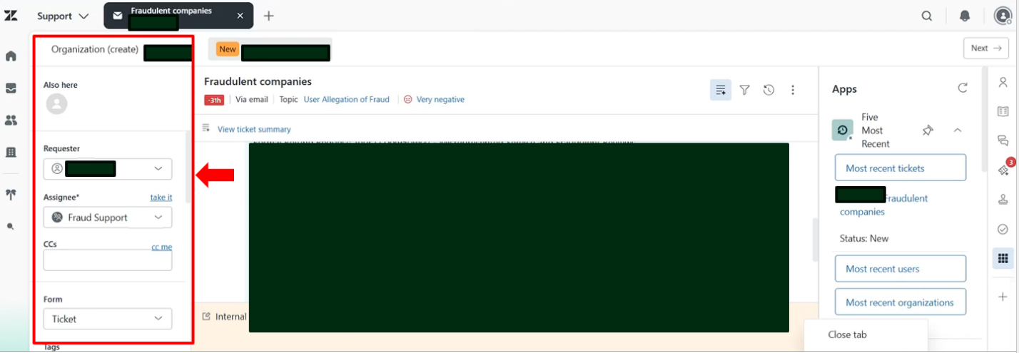
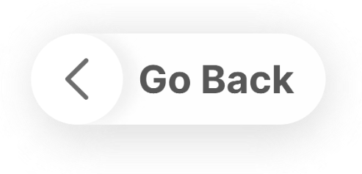
Left-Side Panel – Ticket Fields
Tripadvisor / Fraud support / Interface & navigation

Slide 7
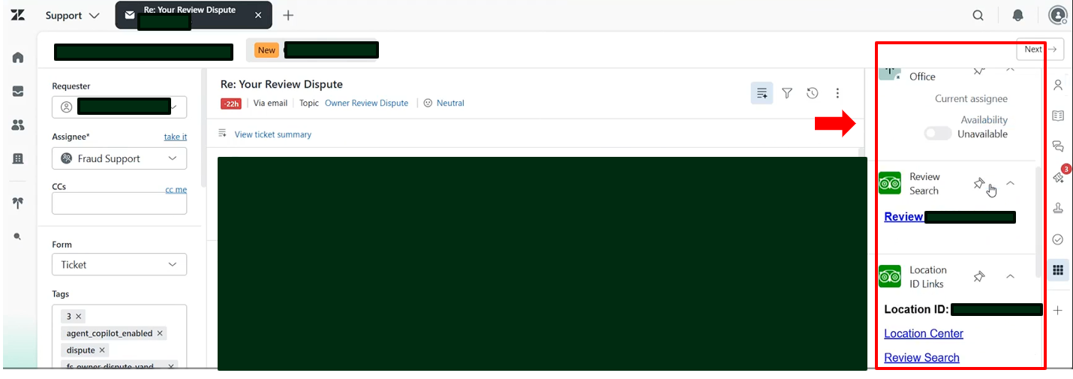
Left-Side Panel – Ticket Fields
Tripadvisor / Fraud support / Interface & navigation

Slide 8
Left-Side Panel – Ticket Fields
Action Triggers & Escalations
Check the following boxes if required:
Red Badge on Property: If Red Badge is posted on the property page.
Penalty Mitigated: If a penalty mitigation is applied
Escalate to Tier 2: If a case needs to be escalated to Tier 2
Property Sweep: If a sweep is performed or requested
Escalate to SGS Second Opinion: If getting a second opinion from your Team leads and QA’s
Sample image
Tripadvisor / Fraud support / Interface & navigation

Slide 9
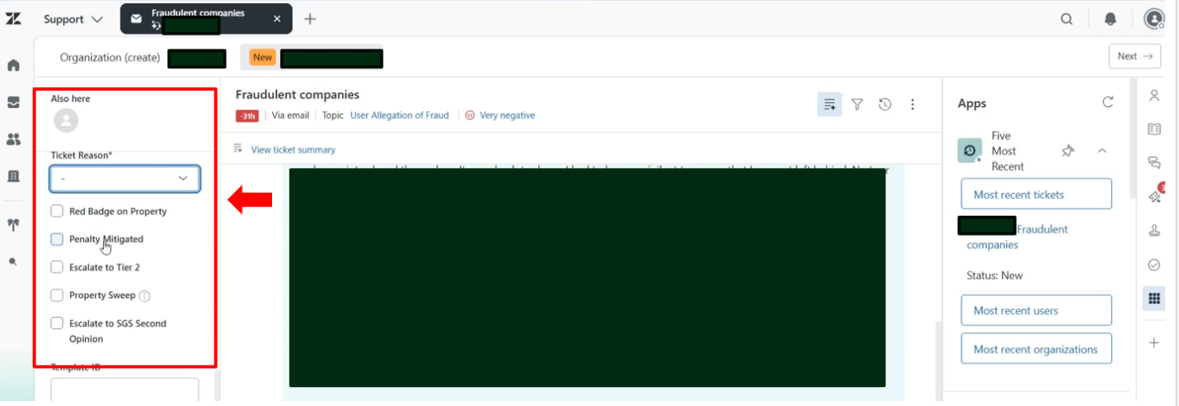
Left-Side Panel – Ticket Fields
Tripadvisor / Fraud support / Interface & navigation

Slide 10
Ticket Status Definitions
The Ticket Lifecycle
New
Fresh unassigned ticket awaiting triage
Open
Assigned to agent; team action required
Pending
Awaiting vital details from requester
On Hold
Paused for internal research/3rd-party review
Solved
Resolution provided to the user
Closed
Automatically closed due to inactivity
Tripadvisor / Fraud support / Ticket status definitions

Slide 11
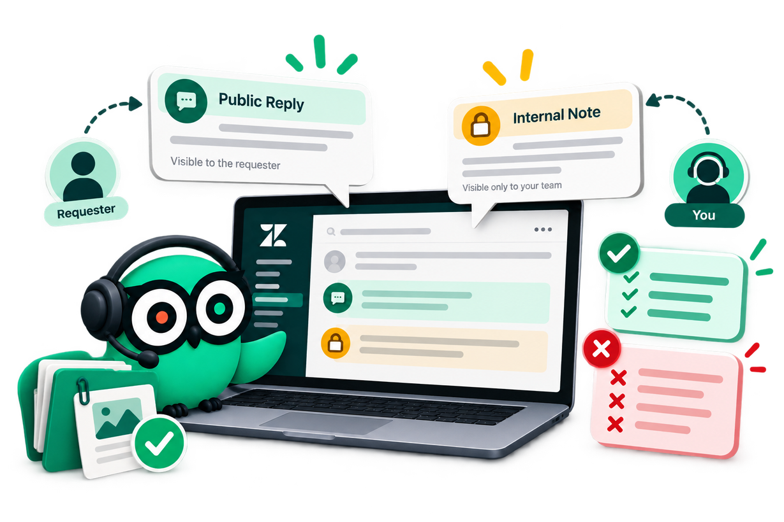
02. Communication Notes
Learn when to write internally and when to speak to the requester — and how to do both right.

Slide 12
Communication Notes
Public Reply vs. Internal Note
Internal Note (Yellow)
Public Reply (White)
Visible only to internal employees
Used for internal documentation only
Document research, decisions, evidence, and actions during investigation
Communicate directly with the ticket requester
Visible to the requester
Review response carefully before sending
Sample image
Sample image
Tripadvisor / Fraud support / Communication notes

Slide 13
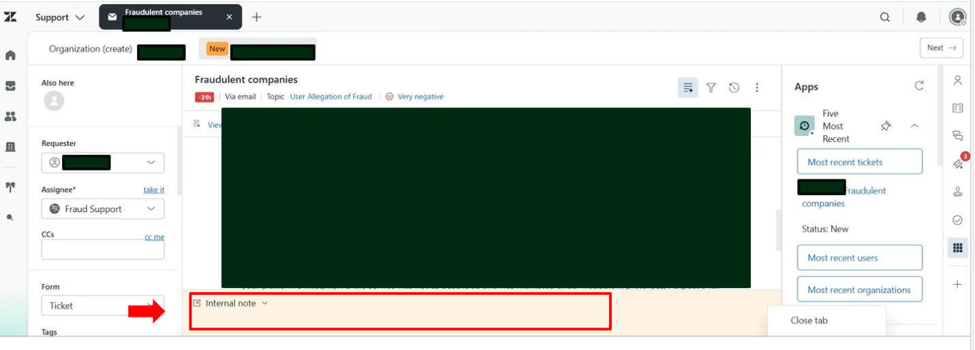
Internal Note
Tripadvisor / Fraud support / Interface & navigation

Slide 14
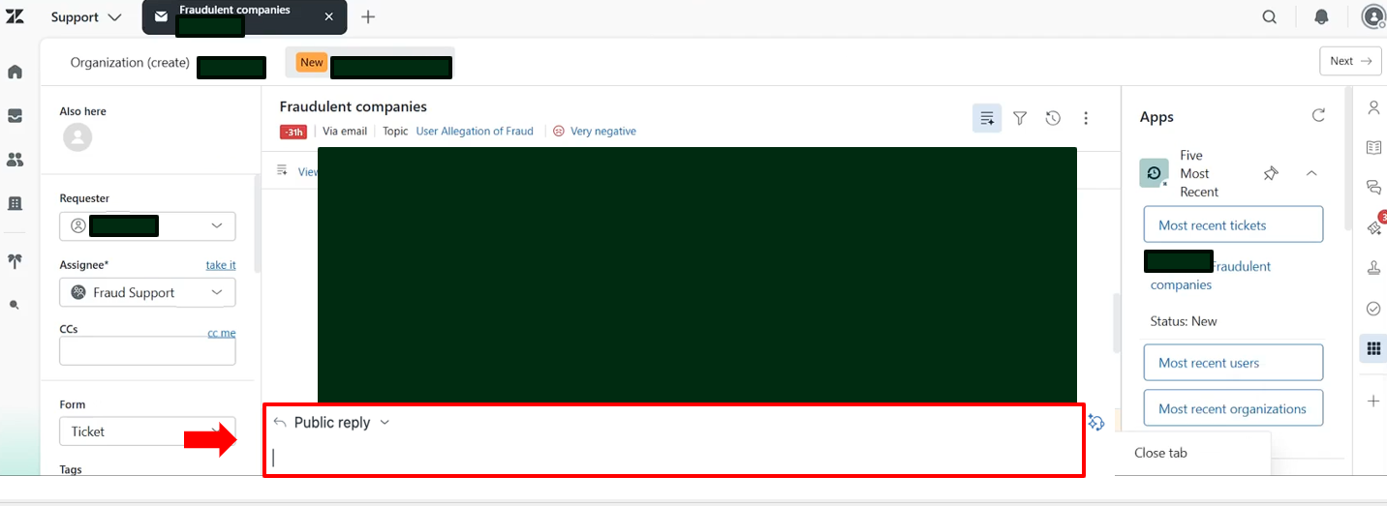
Public Reply
Tripadvisor / Fraud support / Interface & navigation

Slide 15


Communication Notes
DO’S
DONT’S
01
Logic: Explanations of research, decisions, and actions
Bias: Personal opinions about the requester or situation
01
02
Context: Removal reasons and manual translations of evidence
Tone: Overly casual, cryptic, or humorous language
02
03
Data: Specific Review IDs and Location IDs
Media: Screenshots or external file attachments
03
  “Looked at reviews submitted between Sept 1st and Sept 30th, found pattern of formulaic email addresses from 1st-time users, removed as SB”
  “Sent incentive survey for all reviews submitted since August 1st.”
  “Checked the account / Investigated the issue / Contacted owner”
  “Sent incentive surveys”
Tripadvisor / Fraud support / Communication notes

Slide 16
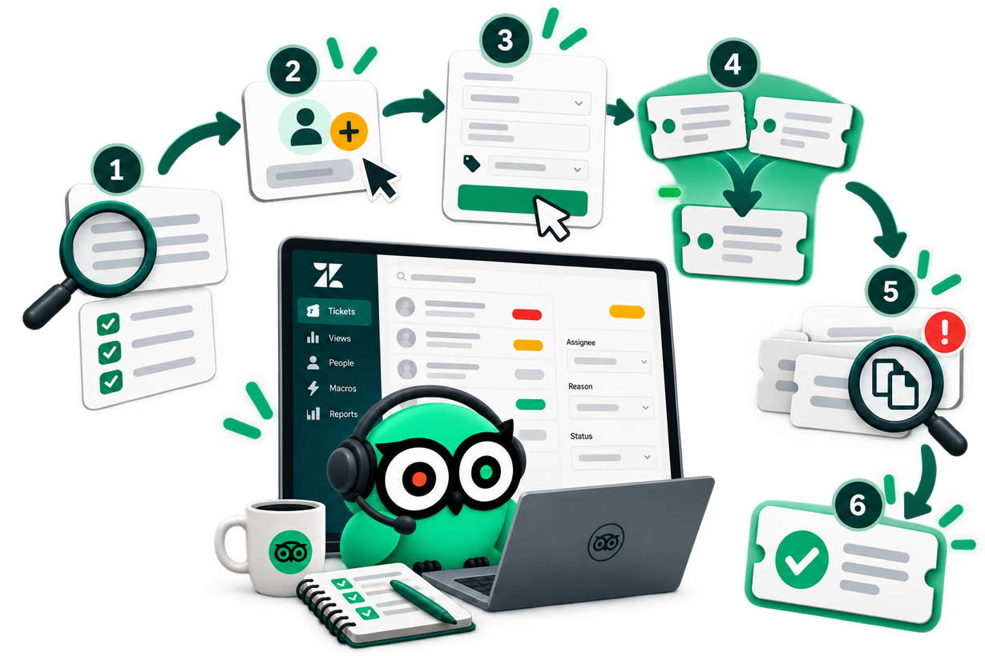
03. How to Work on A Ticket
End-to-end ticket handling — from your first check to merging, duplicates, and closing.

Slide 17


How to work on a ticket: Preliminary Ticket Checks
Before taking action
Daily triage
Evidence-Based Decisions
Identify: Check customer context panel for duplicates
Always process reopened cases before touching new ones.
Base every action solely on hard case evidence
Scan: Look for same-organization cross-filing
Work strictly within your assigned queue chosen from Owner Sourced Tickets, User Sourced Tickets, or FS Main Queue
Follow the latest procedures
Assess: Confirm current ticket status and history
Treat every case fresh
Check all recent relevant tickets; Never cherry-pick or nitpick.
Review: Verify that accounts match before updating
Tripadvisor / Fraud support / How to work on a ticket

Slide 18

Assign the ticket to yourself by clicking
"take it".
Ensure "Ticket" is selected as the Form.
Enter Location ID and Review IDs.
Select the correct
Ticket Reason.
Submit the ticket as "Open" to save changes.
How to work on a ticket: Assign a ticket
Note: Zendesk displays conversations chronologically from top to bottom, placing the newest responses at the very end.
Tripadvisor / Fraud support / How to work on a ticket

Slide 19
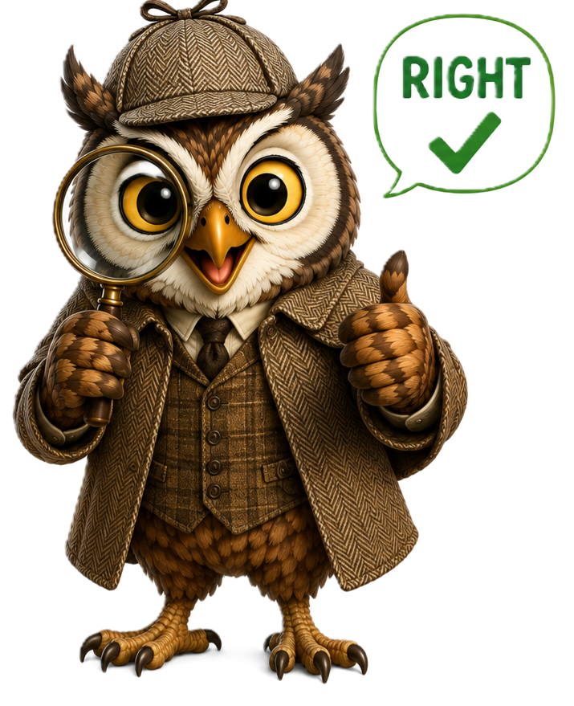
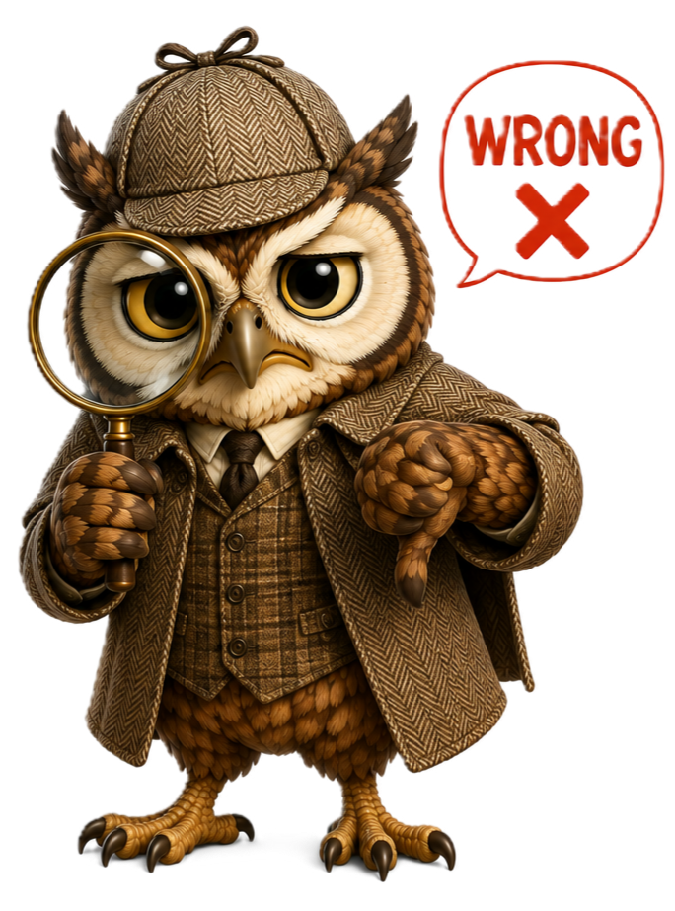
Merging Tickets
Why We Merge Tickets?
Prevent Double Work
Save Effort
Stop Confusion
When Not to Merge
Tickets from an owner and a user, even if they are related to the same review/situation
Tickets from two different owners of the same property
Tickets from the same owner but for 2 different properties/reviews with different issues or fraud pattern
When to Merge
Multiple tickets from the same requester regarding the same topic
Tripadvisor / Fraud support / Merging tickets

Slide 20


Merging Tickets
When to Merge
Multiple tickets from the same requester regarding the same topic
Why We Merge Tickets?
Prevent Double Work
When Not to Merge
Tickets from an owner and a user, even if they are related to the same review/situation
Tickets from two different owners of the same property
Tickets from the same owner but for 2 different properties/reviews with different issues or fraud pattern
Save Effort
Stop Confusion
Tripadvisor / Fraud support / Merging tickets

Slide 21
Duplicate Ticket Handling From the Same Organization
When multiple staff members from the same organization contact us regarding the same issue, do not merge the tickets. Instead, respond to each requester individually.
SUGGESTED RESPONSES
“I noticed we have received other inquiries from your team regarding this matter. To ensure we provide the most efficient support, please designate a single point of contact to handle this correspondence moving forward.”
“I noticed that we have received multiple inquiries from members of your organization regarding the same issue. To streamline communication and ensure everyone receives consistent updates, please have one designated representative communicate with us on behalf of your organization.”
“I understand that several members of your organization have reached out to us regarding this issue, and we appreciate everyone's efforts to help resolve it. To ensure clear, consistent communication and prevent duplicate updates, we kindly ask that your organization nominate one primary contact for this case.”

Slide 22
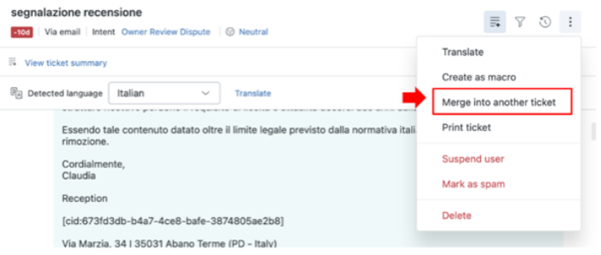
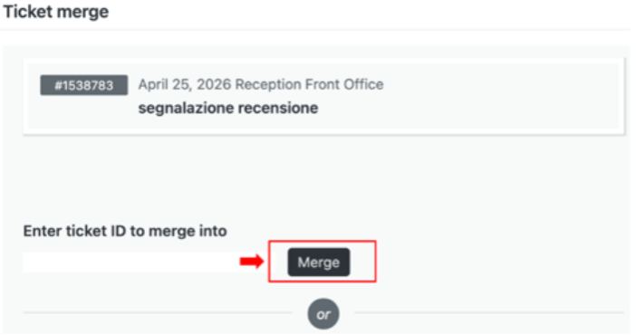
How to Merge Tickets
Select "Merge into another ticket" from the three-dots menu (right top, close to email subject)
Enter the Target Ticket ID
Click "Merge"
Tripadvisor / Fraud support / Merging tickets
Notes:
Additional scenarios:
If an agent identifies a duplicate ticket that is still open, they should merge the two tickets.
However, if the duplicate has already been solved, the agent should close the new ticket and apply the following internal comment:
"Addressed in ticket XXXXX, setting ticket to solved as no further action is needed."

Slide 23

Knowledge Check
Test what you've learned across all three sections before you wrap up.

Slide 24


KNOWLEDGE CHECK
True or False?
Tickets that are unassigned have the status ‘Open'.
TRUE
FALSE
Tickets that are unassigned have the status 'New'.
Tripadvisor / Fraud support / Knowledge check

Slide 25
KNOWLEDGE CHECK
What should agents do if they receive multiple tickets from the same requester regarding the same topic?
Respond individually to each ticket
Merge the tickets
Close all but the recent ticket
Forward to Tier 2 Team
Tripadvisor / Fraud support / Knowledge check

Slide 26
KNOWLEDGE CHECK
What type of communication is visible only to internal employees?
Public Reply
Email to customer
Internal Note
Ticket details
Tripadvisor / Fraud support / Knowledge check

Slide 27
KNOWLEDGE CHECK
True or False?
Agents should always start their day by processing reopened tickets before new ones.
TRUE
FALSE
You’re right!
Tripadvisor / Fraud support / Knowledge check

Slide 28
KNOWLEDGE CHECK
Which ticket status indicates that the case has been resolved, and no further action is required?
New
Open
Solved
Pending
Tripadvisor / Fraud support / Knowledge check

Slide 29
KNOWLEDGE CHECK
How should agents handle duplicate inquiries from multiple staff members of the same organization?
Merge all tickets
Respond to each requester individually
Close all tickets except the recent ticket
Escalate to Tier 2
Tripadvisor / Fraud support / Knowledge check

Slide 30
KNOWLEDGE CHECK
True or False?
Agents can include screenshots from internal files in public replies.
TRUE
FALSE
You’re right!
Tripadvisor / Fraud support / Knowledge check

Slide 31
KNOWLEDGE CHECK
Which of the following should NOT be included in internal notes?
Explanations of research and actions
Personal opinions about the requester
Review and Location IDs
Reasons for removal and translations
Tripadvisor / Fraud support / Knowledge check

